Slide 1
Components
WebServer: This component represents the front-end of the system that interacts with the web application’s users. Can answer their requests with a static content page and dialog, if needed, with the ApplicationServer.
ApplicationServer: Represents the front-end of the system that interacts with mobile application’s users and the Admin’s GUI. Can dialog with other internal logic components.
RidesManager: Handles requests and reservations and, in general, everything that is connected with rides. It is a central part of the application, and is the only component that interacts with the QueueManager.

Slide 2
Components
QueueManager: Manages the taxi zones and queues logic. It memorize (but does not store in the DB) the position of every active taxis received by the GPSInterface.
MessageBroker: Implements the Broker role in the publisher-subscribe pattern. Receives the publication messages from the RidesManager and UsersManager and forward the appropriate communications to the clients.
DataBaseManager: Handles the only access point of the middle tier to the DB tier.

Slide 3
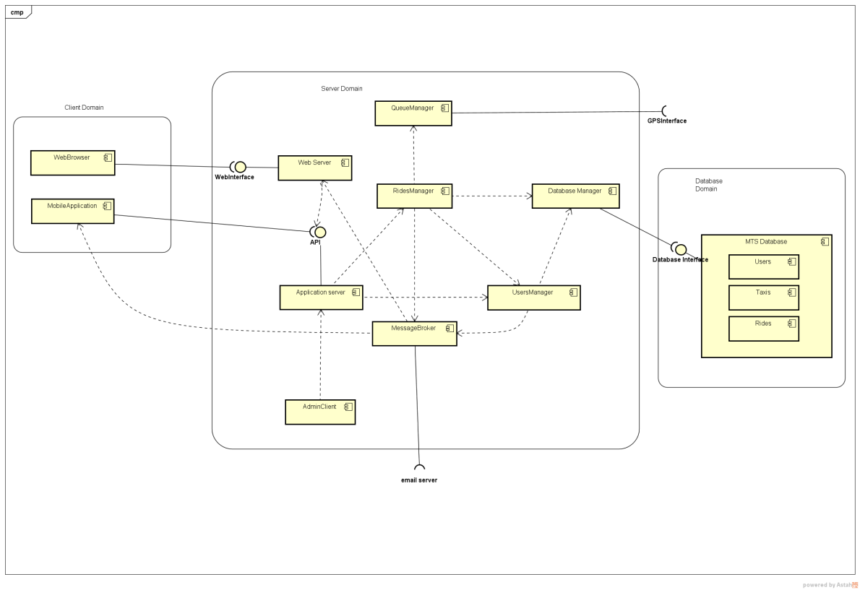
Components

Slide 4
Deployment
Now we need to map the components into real machines!

Slide 5
Deployment
WebClient: Physical machine that runs the client’s browser. It could be for example the personal computer of a customer. This node is separated from the system by the Internet network.
MobileClient: Physical mobile device that runs the mobile version of the application, previously installed. It could be for example the smartphone of a customer. This node is separated from the system by the Internet network.
AdminClient: Physical machine used by administrators in order to access to their reserved functionalities. We think that it should be better to have these machines (there could be more than one) located within the same private network of the MTS Server to achieve a higher level of security.

Slide 6
Deployment
WebServer: This node contains the web server component, which is not located on the same machine of the actual MTS Server. However, our idea is that they should be located within the same private network, even if this is not mandatory.
MTSServer: This node contains all the business logic of the application and is the central part of the whole system. It is separated from the front end users by the Internet network and it’s the only node that is connected with the persistent data in the database.
MTSDatabase: Physical database in which all the persistent data of the application are stored. Also in this case we think that it should be better to have the database in the same private network of the other “server nodes”, both for security and performance concerns.

Slide 7
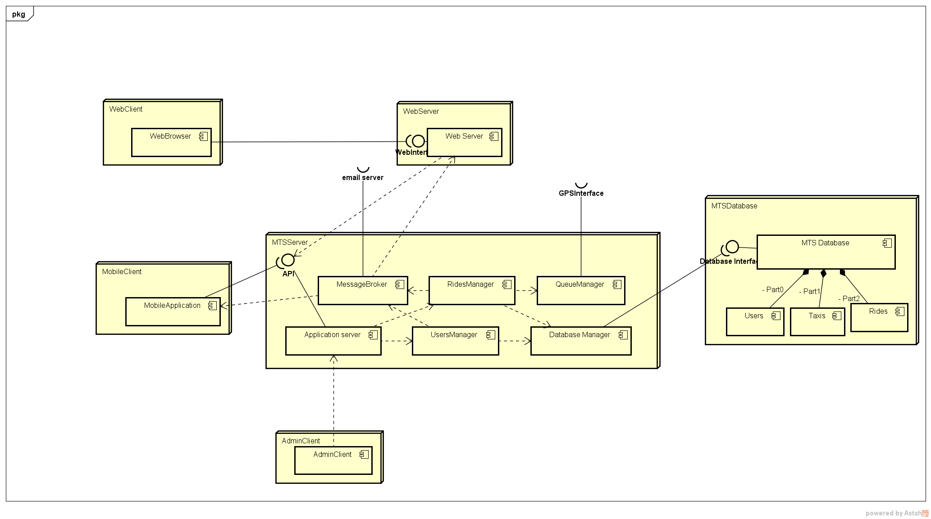
Deployment

